Slide 1
Unit 5
Application Layer
Domain Name System
25.1

Slide 2
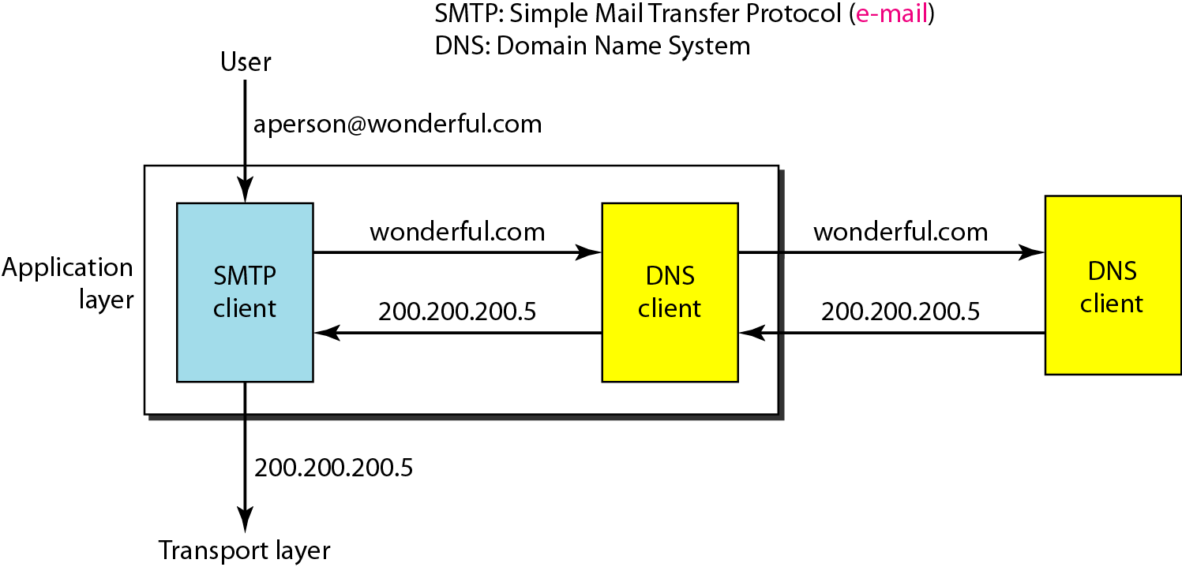
Figure 25.1 Example of using the DNS service
25.2

Slide 3
25-1 NAME SPACE
To be unambiguous, the names assigned to machines must be carefully selected from a name space with complete control over the binding between the names and IP addresses.
Flat Name Space Hierarchical Name Space
25.3

Slide 4
25-2 DOMAIN NAME SPACE
To have a hierarchical name space, a domain name space was designed. In this design the names are defined in an inverted-tree structure with the root at the top. The tree can have only 128 levels: level 0 (root) to level 127..
Label
Domain Name Domain
25.4

Slide 5
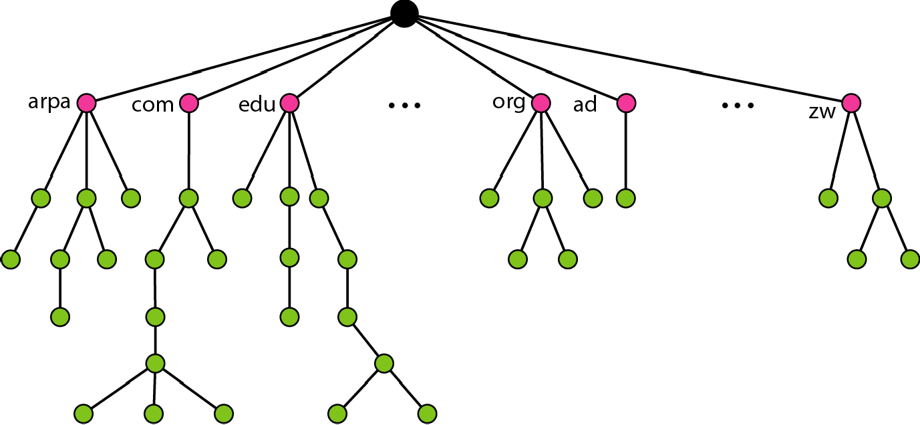
Figure 25.2 Domain name space
25.5

Slide 6
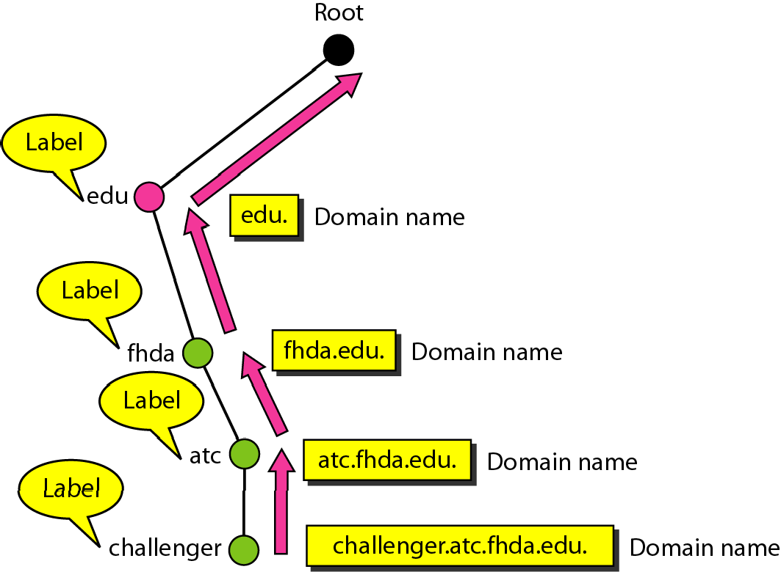
Figure 25.3 Domain names and labels
25.6

Slide 7

Figure 25.4 FQDN and PQDN
25.7

Slide 8
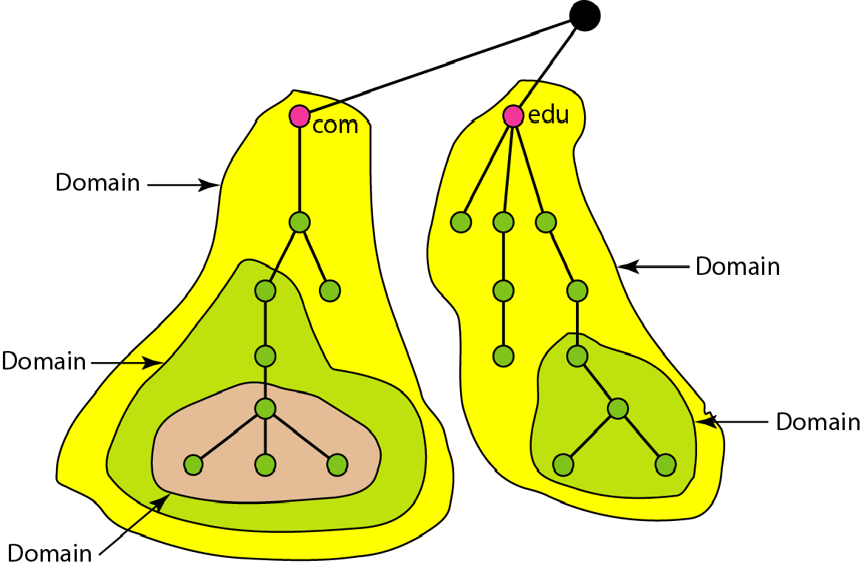
Figure 25.5 Domains
25.8

Slide 9
25-3 DISTRIBUTION OF NAME SPACE
The information contained in the domain name space must be stored. However, it is very inefficient and also unreliable to have just one computer store such a huge amount of information. In this section, we discuss the distribution of the domain name space..
Topics discussed in this section:
Hierarchy of Name Servers Zone
Root Server
Primary and Secondary Servers
25.9

Slide 10
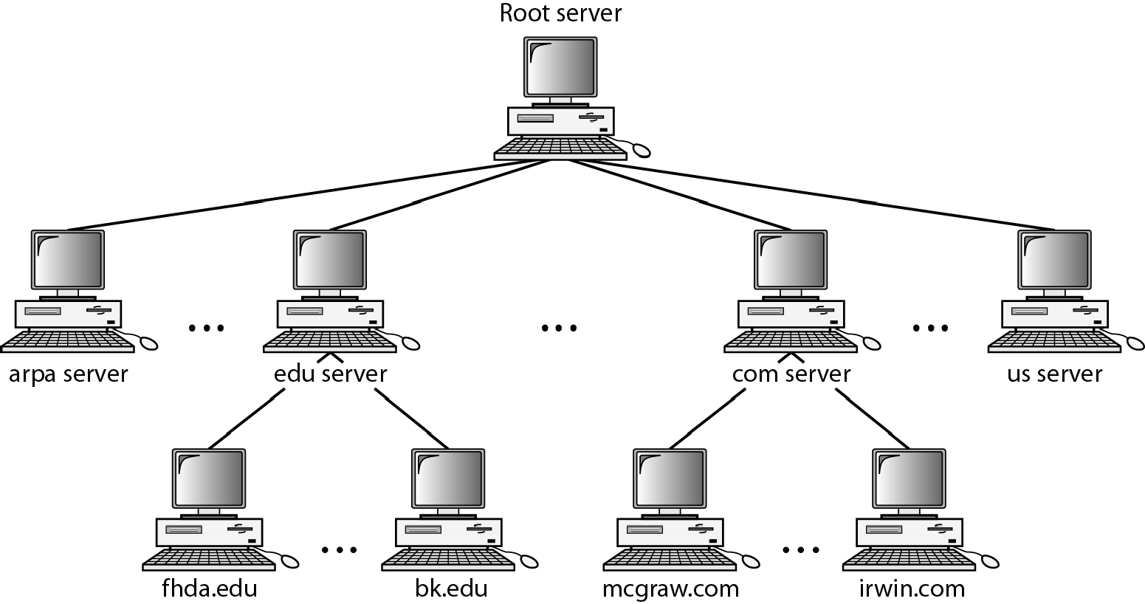
Figure 25.6 Hierarchy of name servers

Slide 11
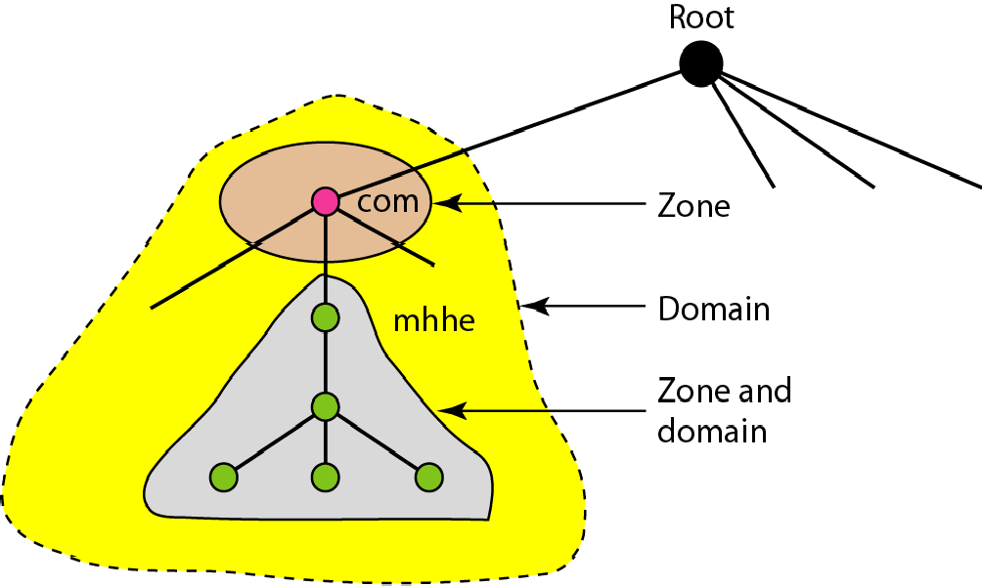
Figure 25.7 Zones and domains

Slide 12

Note
A primary server loads all information from the disk file; the secondary server loads all information from
the primary server.
When the secondary downloads information from the primary, it is called zone transfer.

Slide 13
25-4 DNS IN THE INTERNET
DNS is a protocol that can be used in different platforms. In the Internet, the domain name space (tree) is divided into three different sections: generic domains, country domains, and the inverse domain.
Topics discussed in this section:
Generic Domains Country Domains Inverse Domain

Slide 14
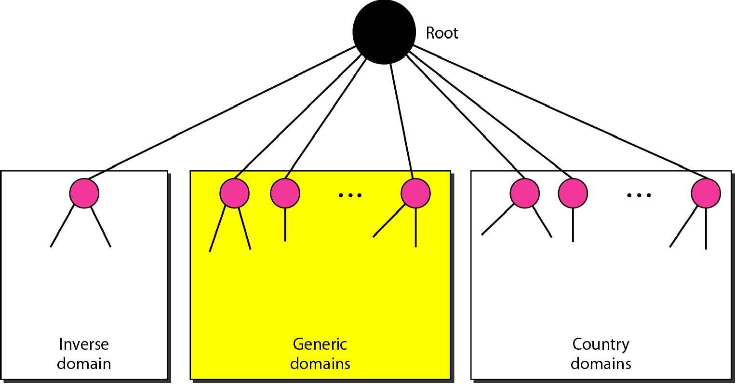
Figure 25.8 DNS IN THE INTERNET

Slide 15
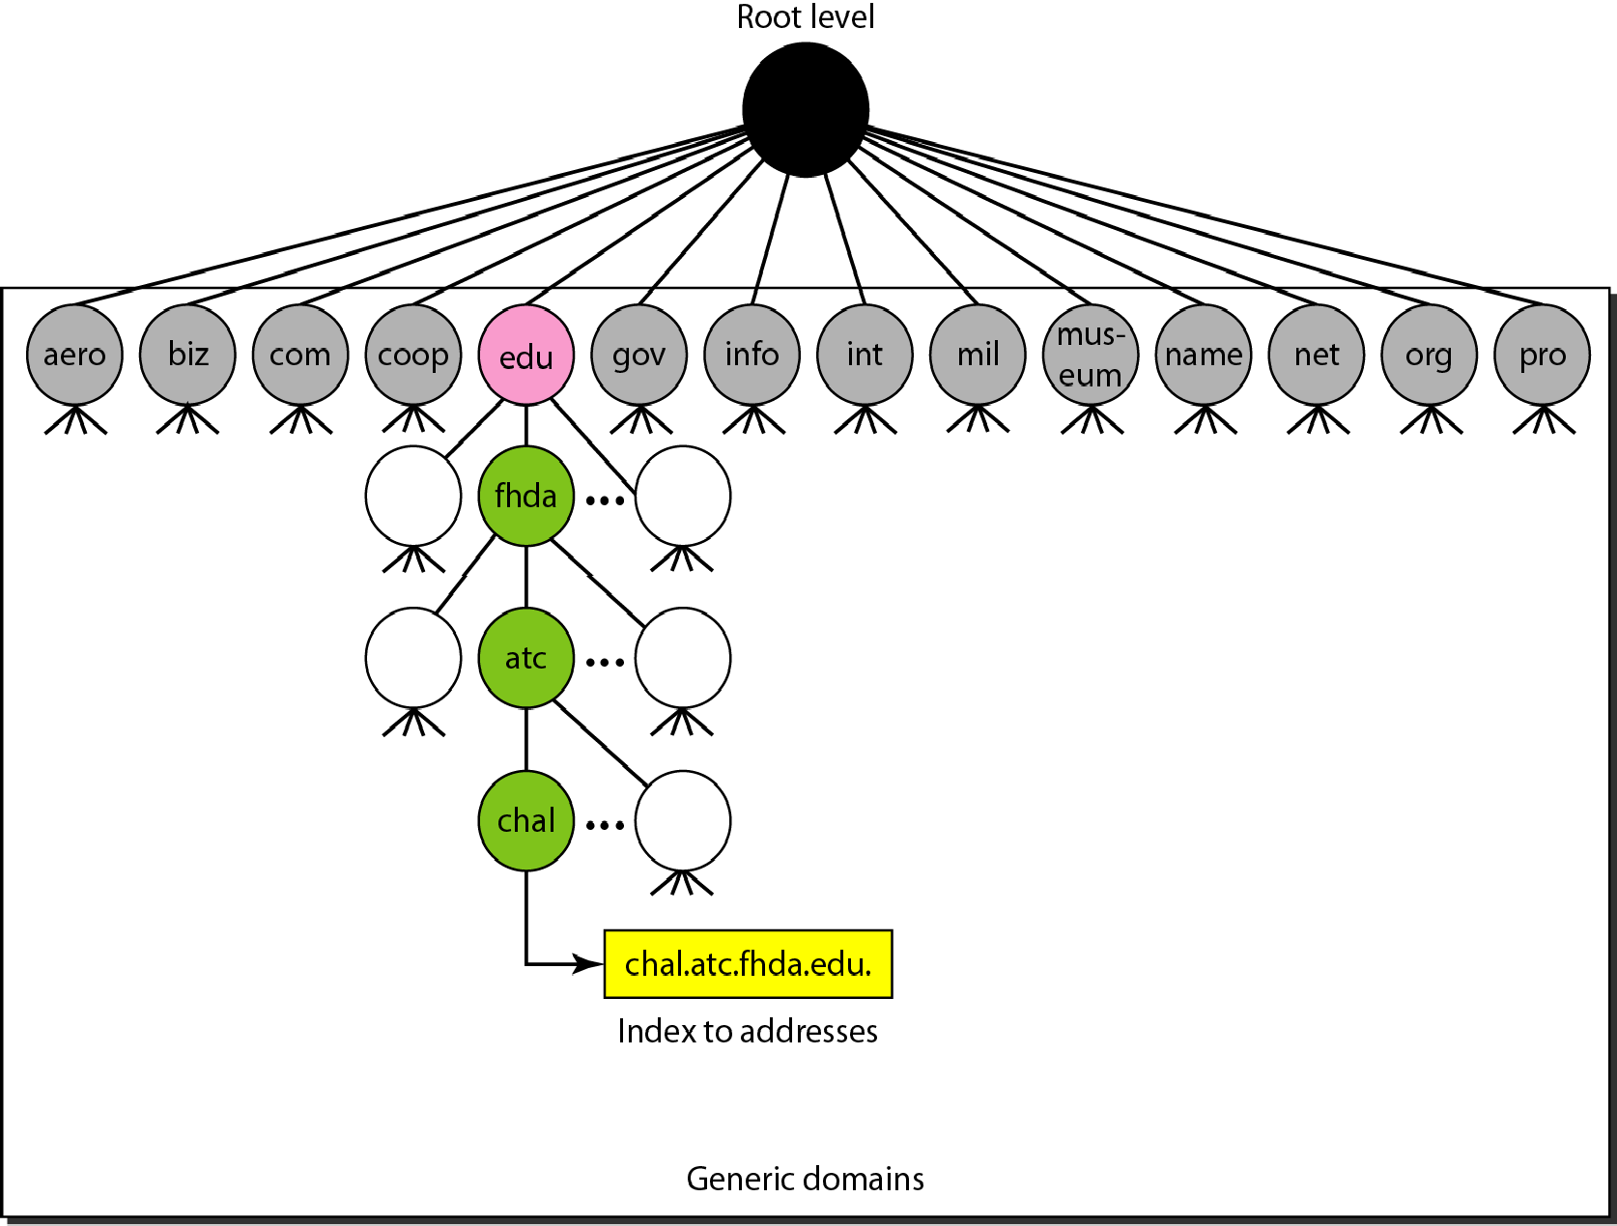
Figure 25.9 Generic domains

Slide 16
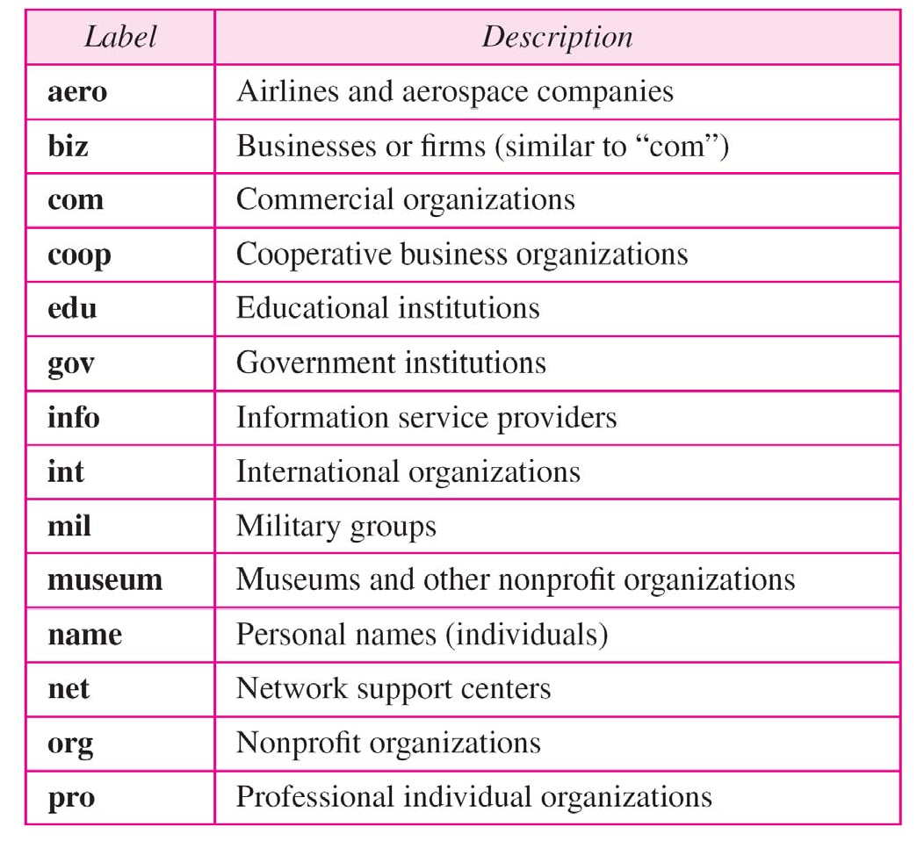
Table 25.1 Generic domain labels

Slide 17
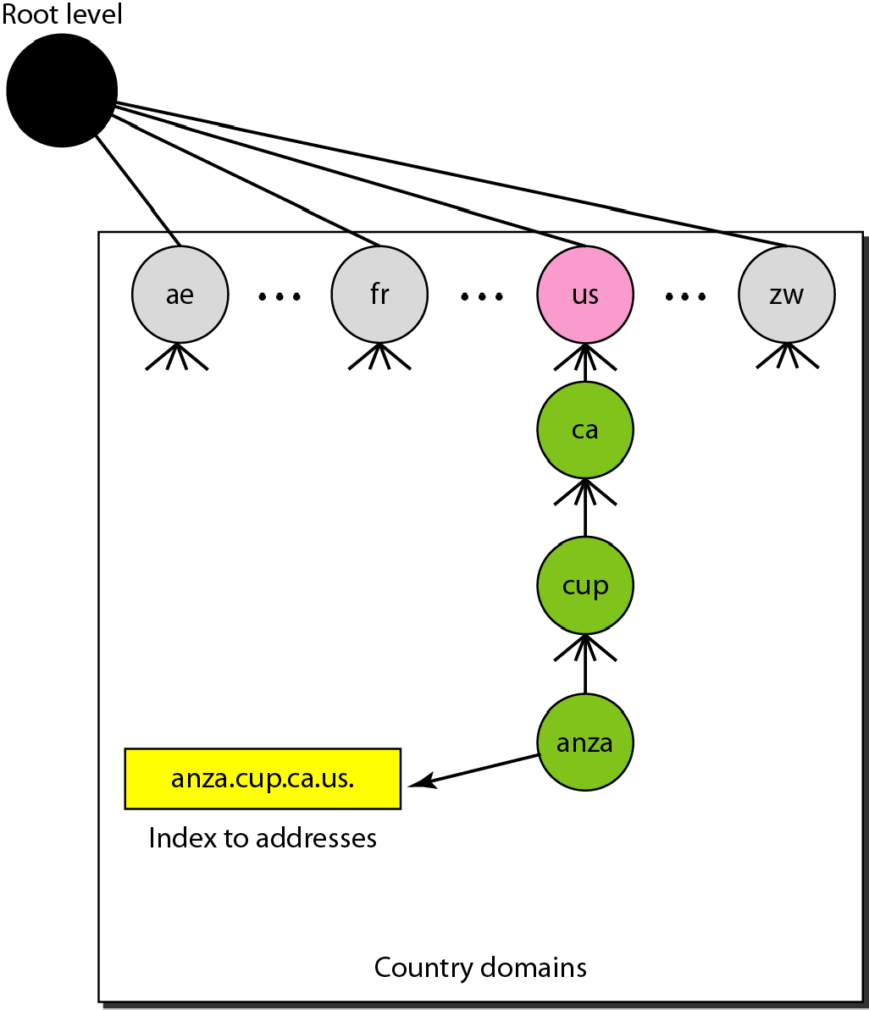
Figure 25.10 Country domains

Slide 18
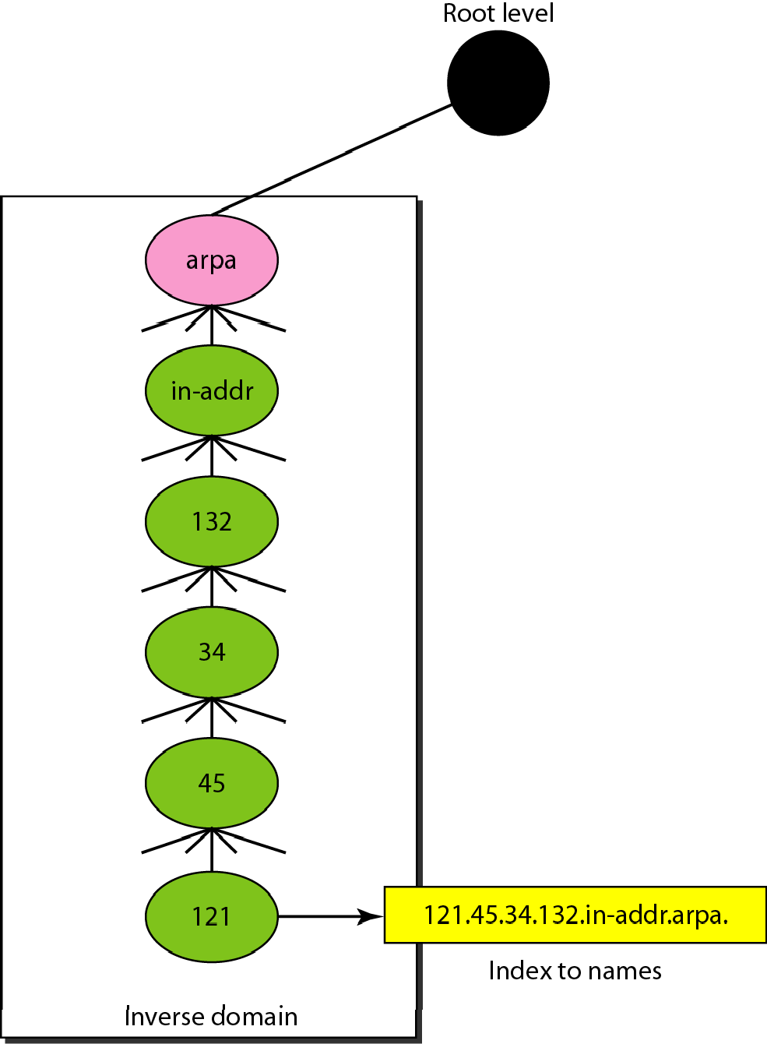
Figure 25.11 Inverse domain
The inverse domain is used for mapping an address to a name.
When the server has received a request from the client, and the server contains the files of only authorized clients.
To determine whether the client is on the authorized list or not, it sends a query to the DNS server and ask for mapping an address to the name.

Slide 19
25-5 RESOLUTION
Mapping a name to an address or an address to a name is called name-address resolution.
Topics discussed in this section:
Resolver
Mapping Names to Addresses Mapping Addresses to Names Recursive Resolution Caching

Slide 20
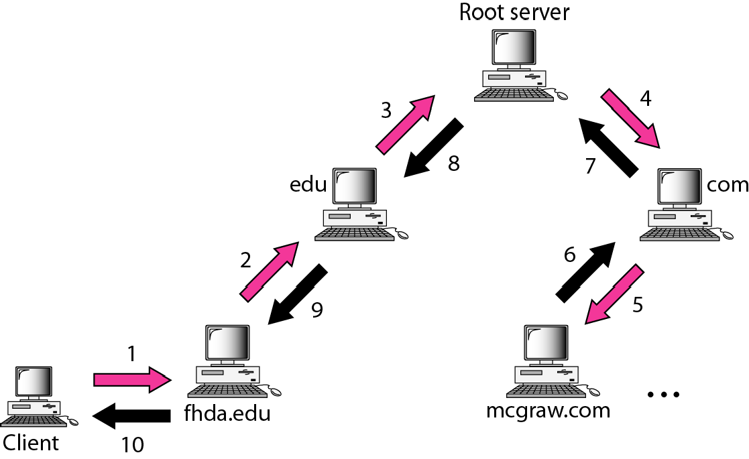
Figure 25.12 Recursive resolution

Slide 21
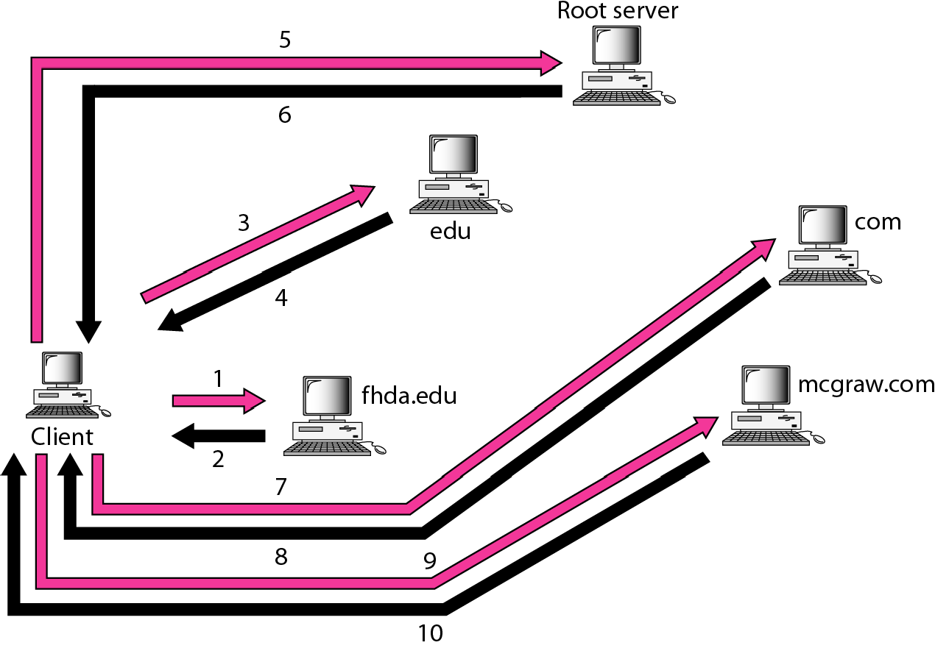
Figure 25.13 Iterative resolution

Slide 22
25-6 DNS MESSAGES
DNS has two types of messages: query and response.. Both types have the same format. The query message consists of a header and question records; the response message consists of a header, question records, answer records, authoritative records, and additional records.
Topics discussed in this section:
Header

Slide 23
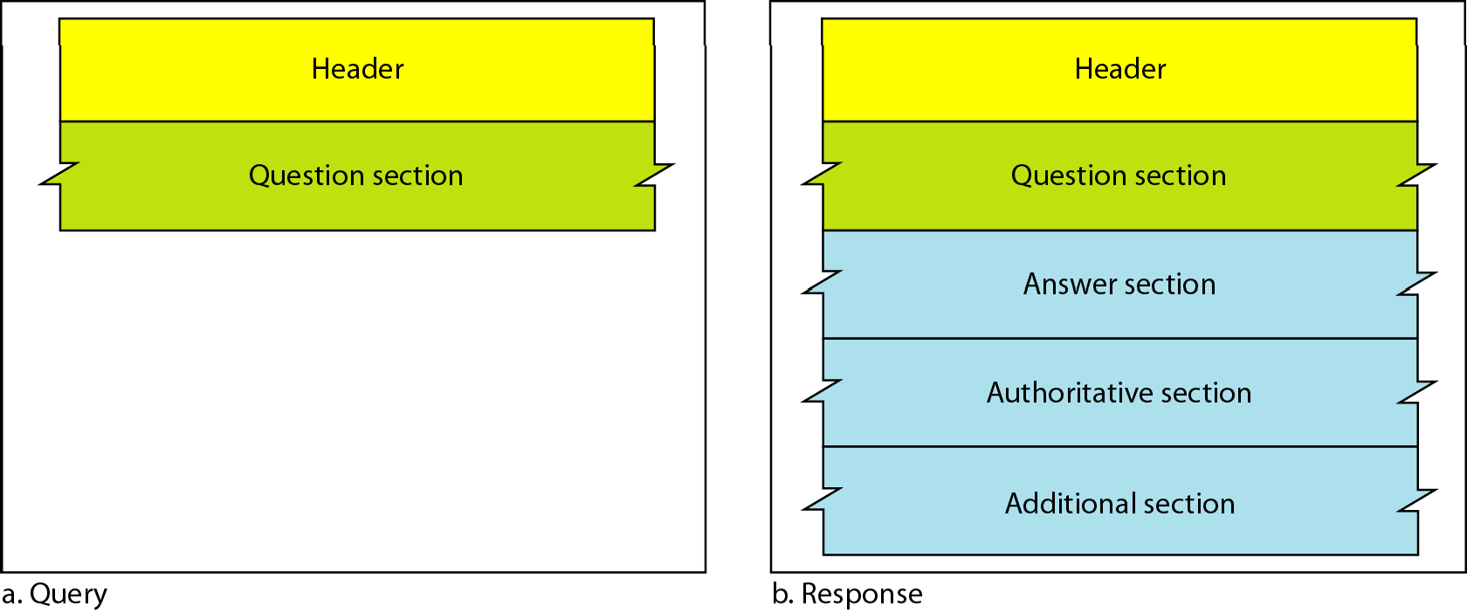
Figure 25.14 Query and response messages

Slide 24
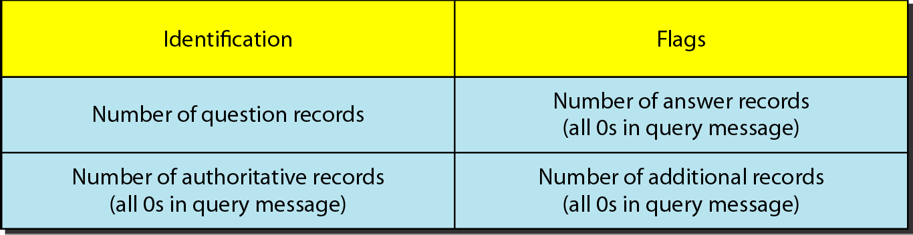
Figure 25.15 Header format

Slide 25
25-7 TYPES OF RECORDS
As we saw in Section 25..6,, two types of records are used in DNS. The question records are used in the question section of the query and response messages.. The resource records are used in the answer, authoritative, and additional information sections of the response message.
Topics discussed in this section:
Question Record Resource Record

Slide 26
25-8 REGISTRARS
How are new domains added to DNS? This is done through a registrar, a commercial entity accredited by ICANN.. registrar first verifies that the requested domain name is unique and then enters it into the DNS database.. A fee is charged..

Slide 27
25-9
DYNAMIC DOMAIN NAME SYSTEM (DDNS)
The DNS master file must be updated dynamically.. The Dynamic Domain Name System (DDNS) therefore was devised to respond to this need.. In DDNS, when a binding between a name and an address is determined, the information is sent, usually by DHCP to a primary DNS server. The primary server updates the zone.. The secondary servers are notified either actively or passively.

Slide 28
25-10 ENCAPSULATION
DNS can use either UDP or TCP.. In both cases the well-known port used by the server is port 53. UDP is used when the size of the response message is less than 512 bytes because most UDP packages have a 512-byte packet size limit.. If the size of the response message is more than 512 bytes, a TCP connection is used.

Slide 29

Note
DNS can use the services of UDP or TCP using the well-known port 53.

